Slide 1
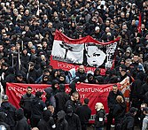
RISE OF NAZISM IN GERMAN

Slide 2
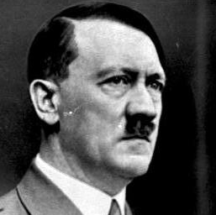
EARLY CAUSES OF HITLER
Birth
Hitler in Vienna
Hitler and the 1st World war
Entry in Politics
Hitler Revolt against Republican Government

Slide 3

CAUSES OF RISE OF HITLER AND THE NAZI PARTY
Weakness of Weimar Republic
Economic depression of 1929
Fear of Communism
Death of the President Albert
Weakness of Republic

Slide 4
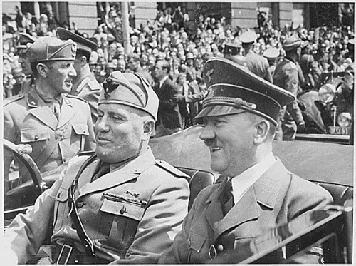
NAZI PARTY AND HITLER'S RISE TO POWER
Formation of Nazi Party
Rise of Nazi Party
Appointment of Hitler as a chancellor
Hitler become dictator of German

Slide 5
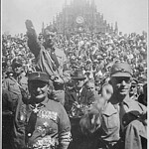
AIM AND PRINCIPLE OF NAZI PARTY

Slide 6
Causes of the success of Nazi Party
Weakness of Weimer Republic
Economic Crisis of 1929
Principle and Propagation of Nazi Party
Good organisation of Nazi Party
Individual Army of the Nazi Party

Slide 7
Domestic Policy of Hitler
Establishment of Totalitarian State
Employment Scheme
Formation of Labour fronts
Efforts to rise German population
Suppression of jews
Educational policy
Establishment of Gestapo
Religious policy

